Slide 1
What is a Mid-Latitude Cyclone?

Slide 2
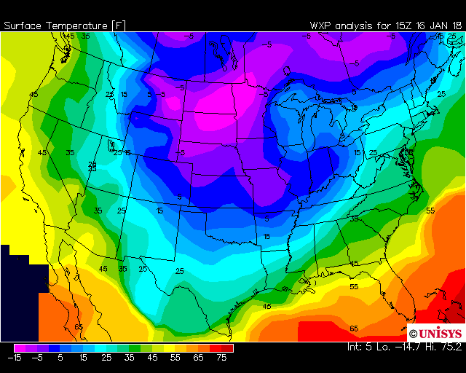
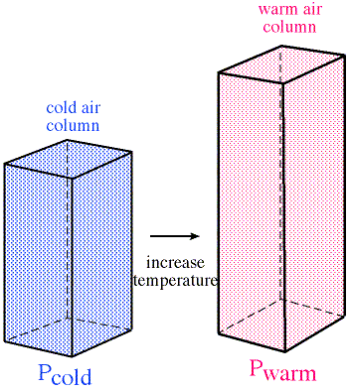
Influence of Temperature
As a column of air increases in temperature, it will expand as volume increases. As a result, two columns of air with a different temperature will have a horizontal pressure difference between them.
Colder and Thinner
Strongest difference in the winter because of the large temperature gradient between the Tropics and the Poles.
Warmer and Thicker

Slide 3
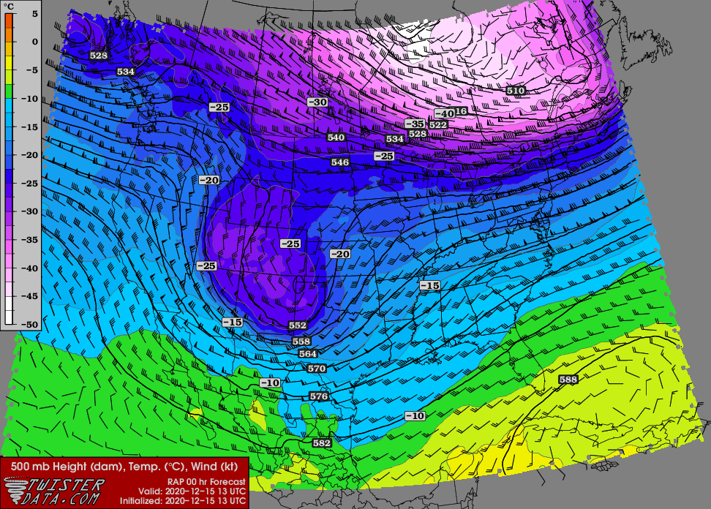
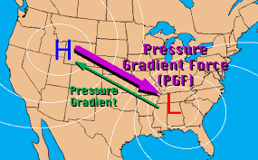
Temperature and Pressure
Air will flow from high to low pressure due to the pressure gradient force, following the same general process of water flowing downhill.
A low pressure would be the bottom of a bowl while a high pressure would be the top of the bowl.
Meteorologists often look at the change in height on a surface of constant pressure so that the concepts can be used together.

Slide 4
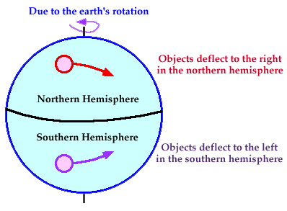
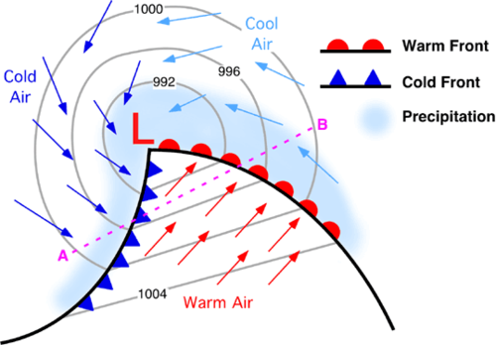
Coriolis Effect
As air flows from one air mass to another, the Coriolis effect causes the winds to move (or more precisely deflect) in a curve.
The Coriolis effect occurs because the Earth is spinning underneath the atmosphere. It’s is called an “apparent” deflection since the air isn’t actually moving in a curve (it just appears to be since the Earth is curved and spinning).

Slide 5
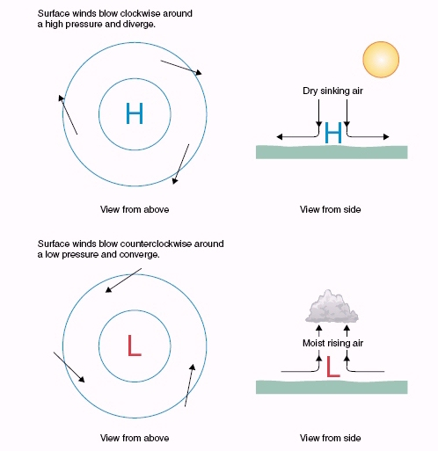
The Start of the Cyclone
Due to the horizontal pressure gradient and the Coriolis deflection, in the Northern Hemisphere air flows clockwise around a high pressure and counterclockwise around a low pressure.
The opposite is true in the Southern Hemisphere.

Slide 6
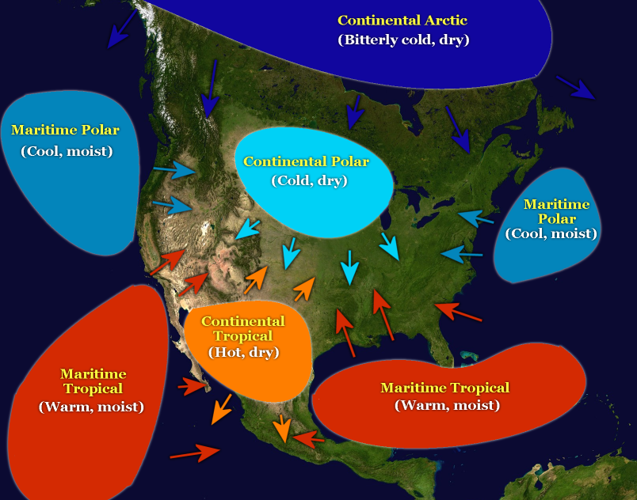
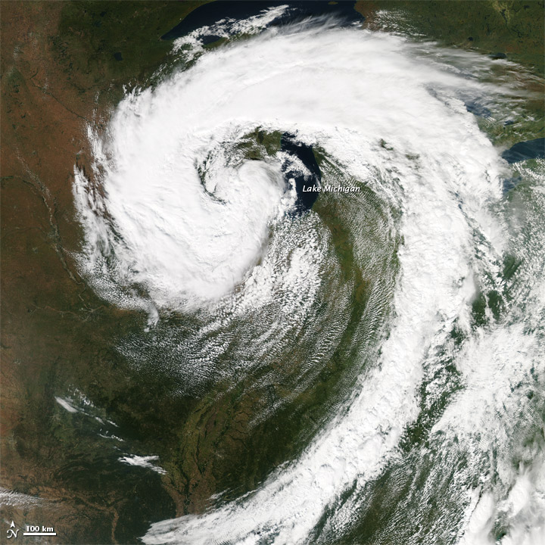
What’s in a Name?
The low pressure area and the associated flow around it is called a mid-latitude cyclone.
“Mid-latitude” since the temperature boundary usually occurs between the Polar and Tropical air masses in the middle latitudes.
“Cyclone” since the air is moving around the center of low pressure.

